Slide 1
UAPian Online Library
ID:
16201146
16201134

Slide 2
Use Case for UAPian Online Library
Use Case | Actors
Inquire for Membership | Student
Request for Book Issue | Student
Request for Book Return | Student
Pay Fine | Student
Search Book | Student
Issue Membership Card | Librarian
Cancel Membership | Librarian
Issue Books | Librarian
Maintain the Book Record | Librarian
Add Books | Librarian
Remove Books | Librarian
Update Books | Librarian
Return Books | Librarian
Update Member Details | Librarian
Charge Fine in Late Return | Librarian

Slide 3
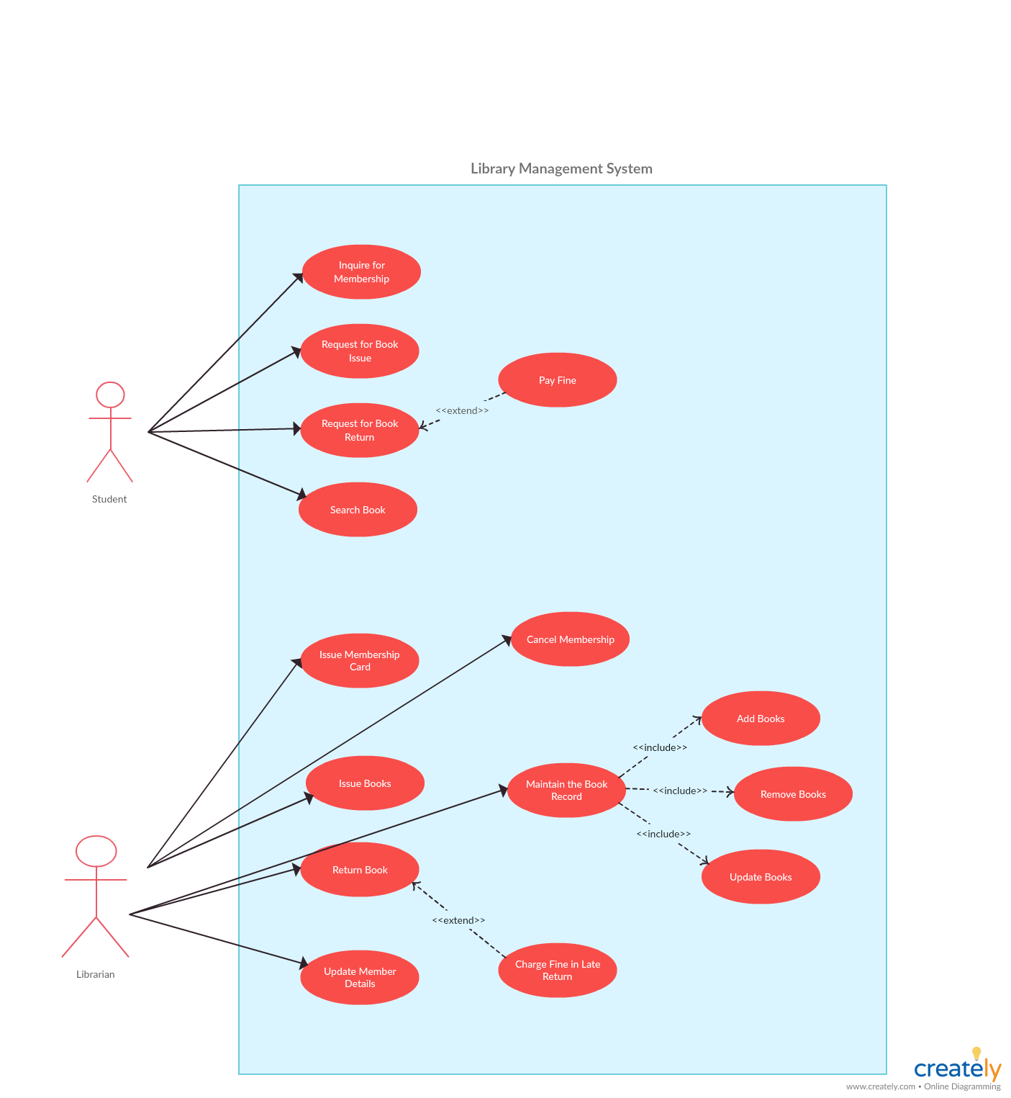

Slide 4
Use Case Narrative
Name : Inquire for Membership, Request for Book Issue, Request for Book Return, Pay Fine, Search Book, Issue Member Card, Cancel Membership, Issue Books, Maintain the Book Records, Add Books, Remove Books, Update Books, Return Book, Update Member Details, Charge Fine in Late Return.
Priority : High
Primary Actor : Student
Secondary Actor : Librarian

Slide 5
Use Case Narrative
Student Inquire for Membership
Student Request for Book Issue and Book Return
Student Pay Fine for Late Return
Student Can Search Book
Librarian Can Issue and Cancel Membership Card
Librarian Issue Books
Librarian Maintain the Book Records by Adding, Removing, Updating and Returning Books
Librarian Can Update Member Details
Librarian Can Charge Fine in Late Return

Slide 6
Thank You

